Slide 1

RooHub
By Team 8
Sree Rama Raju Pericharla - 45
Shanmukha Reddy Aalla - 01
Tejaswi Ganne - 11
Sri Praneeth Iyyapu - 16

Slide 2
Architecture
Iphone
Rest Services
RooHub
Database
Webpage
Android

Slide 3
Features
Ready to use application on android, ios mobile devices and as a web application
Create user profile and log in to the application
Updating user profile
Posting posts in boardrooms
Retrieving posts in boardrooms
Creating tasks personal tasks and public tasks
Retrieving the tasks created
Syncing tasks to the google calendar

Slide 4
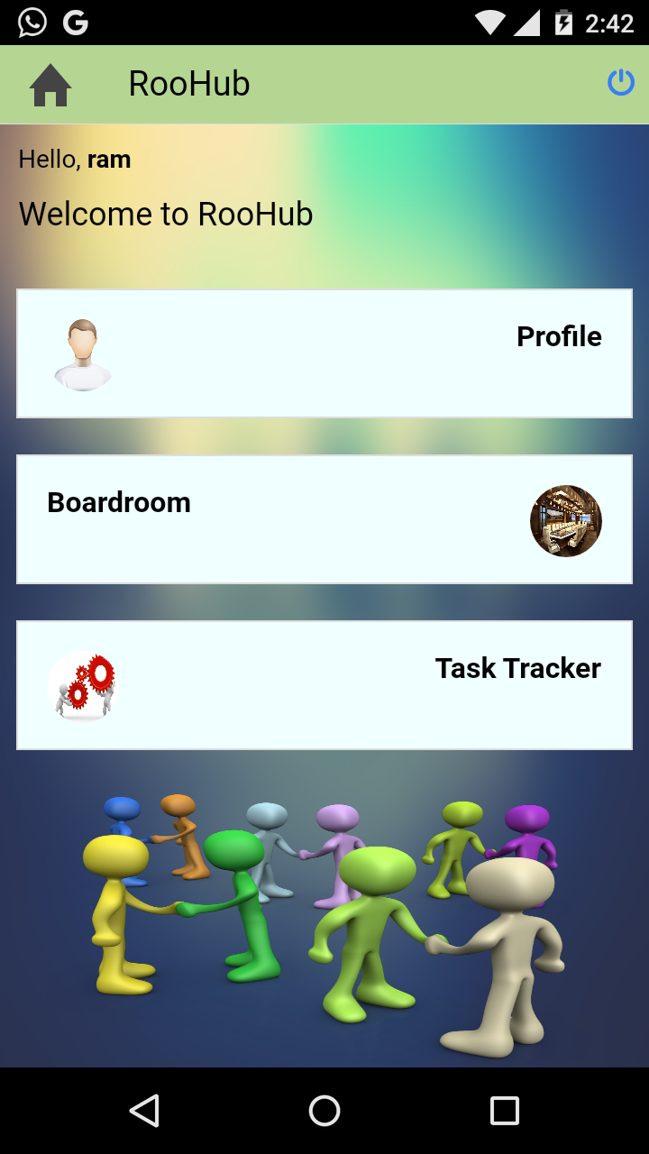
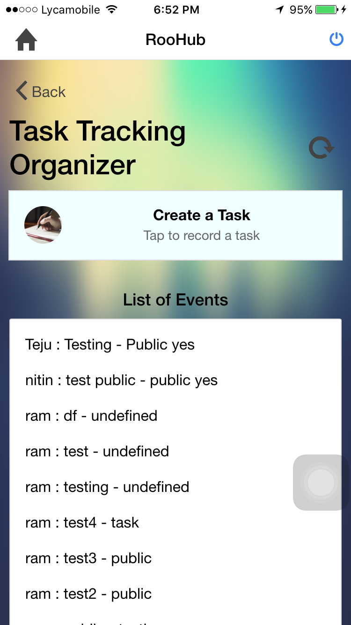
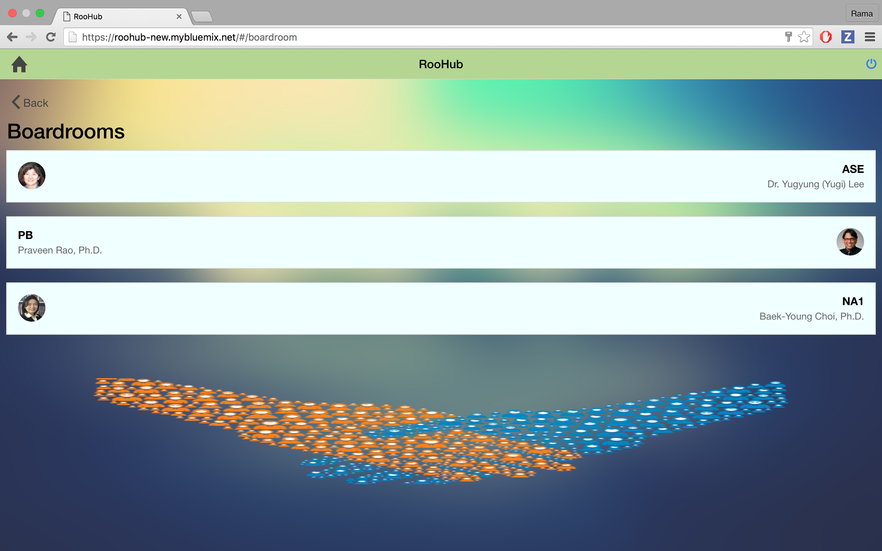
web
android
ios

